Slide 1
Analytical Methods : Important Concepts
Feb’10

Slide 2
Topics
T-Test
Kolmogorov - Smirnov Test (KS)
Lorenz Curve
Gini Co-efficient
Correlation
Normalization - Box-Cox Transformation
Co-Variance
Maximum Likelihood Estimation

Slide 3
T-Test
T-test is a statistical hypothesis test in which the test statistic follows a Students t distribution if the null hypothesis is true
Commonly applied when the test statistic would follow a normal distribution
T statistics have the form t=Z/s where
Z follows a Standard Normal Distribution under the null hypothesis
ps² follows a chi-square with p deg of freedom under null hypothesis
Z and s are independent
Unpaired two sample t-tests is conducted for independent observations i.e. 100 people divided into 2 groups of 50 for study
Paired two sample t-tests is conducted for dependent observations i.e. 100 people studied before and after delivery of a drug

Slide 4




T-Test
Independent one-sample T-test:
In testing the null hypothesis that the mean of a specified sample is equal to μ₀ the statistic used is where s is the sample std dev and n is the Sample size
Independent two-sample T-test:
In general the statistic used is where where s² is the unbiased estimator of the variance of the two samples, n = number of participants, 1 = group one, 2 = group two
In significance testing the statistic is approximated to Students-t distribution with degree’s of freedom being calculated as
ν =

Slide 5

T-Test
Carry out test of null hypothesis that the screw weights in the two samples are equal
T Test Statistic = 0.095/0.0485 = 1.959
Average = 30.015
Std. dev. = 0.049
N = 6
Average = 29.92
Std. dev. = 0.108
N = 6
=((0.049)²/6 + (0.108)²/6)^{1/2}
The two tailed test p –value is approximately 0.091 and the one tailed p-value is approximately 0.045

Slide 6
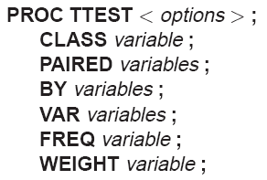






PROC TTEST
Underlying assumption is that observations are drawn from a normal distribution
If the samples are not normally distributed then procedure NPAR1WAY must be used
Computational Methods
Individual Mean
Paired difference
Individual Samples
Folded Form F Stat
Satterthwaite’s Approximation

Slide 7
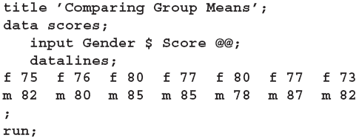

Illustration : PROC TTEST
SAS Steps
Golf Scores for Genders are tabulated
Groups T Test is conducted to compare means if men perform significantly different from women
Cochran option produces p-value for unequal variance situation using Cochran and Cox Approximation
Equal Tails and Uniformly Most Powerful Unbiased (UMPU) confidence intervals for σ are requested using CI= option
Class contains the group variable across which test is to be conducted

Slide 8
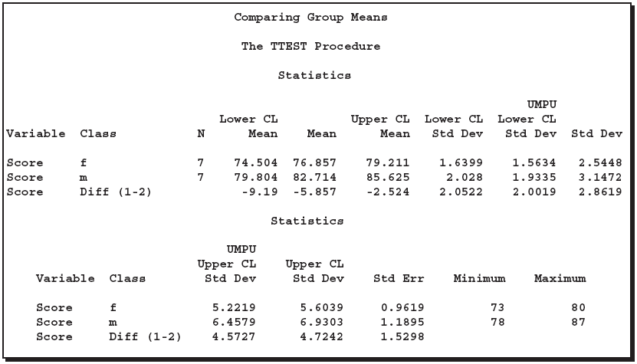
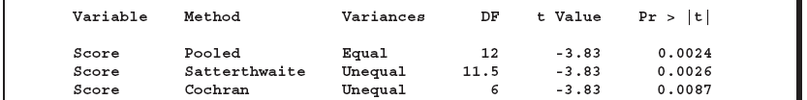
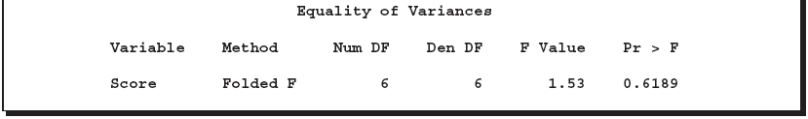
Illustration : PROC TTEST
SAS Output

Slide 9
Kolmogorov Smirnov Test
KS Statistic quantifies the distance between empirical distribution function of the sample and the cumulative density function of the reference distribution or between two empirical distributions
The null distribution of this statistic is calculated under the null hypothesis that the samples are drawn from the same distribution (in the two-sample case) or that the sample is drawn from the reference distribution (in the one-sample case)
KS Test may also be used to test whether two underlying one-dimensional probability distributions differ

Slide 10

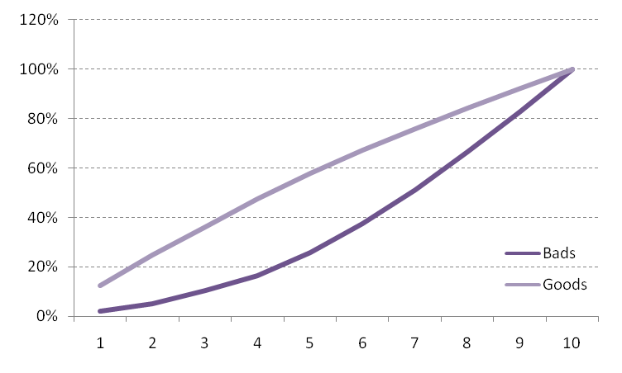
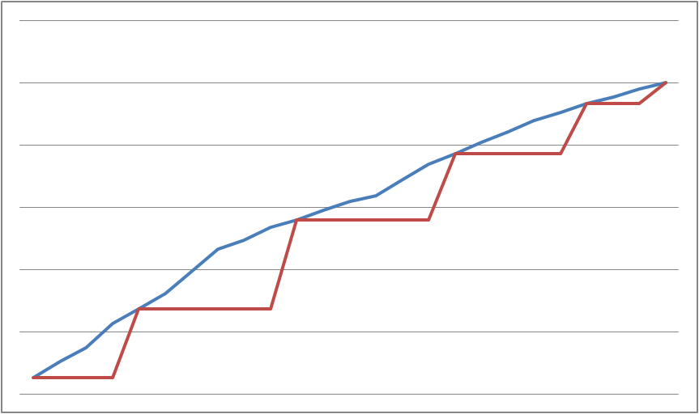
Illustration : KS Test
The empirical distribution function F_{n} for n iid observations X_{i} is defined as
where is the indicator function, equal to 1 if X_{i} ≤ x and equal to 0 otherwise.
The Kolmogorov–Smirnov statistic for a given cumulative distribution function F(x) is
where sup S is the supremum of set S.

Slide 11
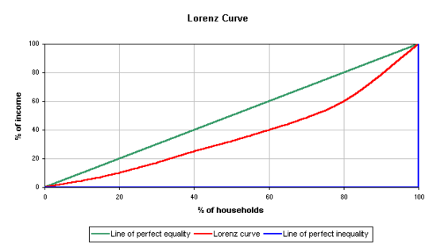

Lorenz Curve and Gini
Graphical representative of cumulative density function of an empirical probability density
For a pdf f(x) with the cumulative distribution function F(x), the Lorenz curve L(F(x)) is given by:
Gini Coefficient = 2*Area A
A
B

Slide 12
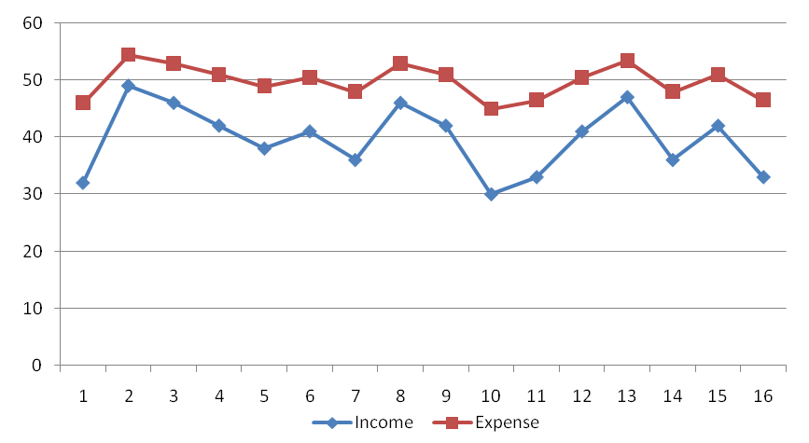
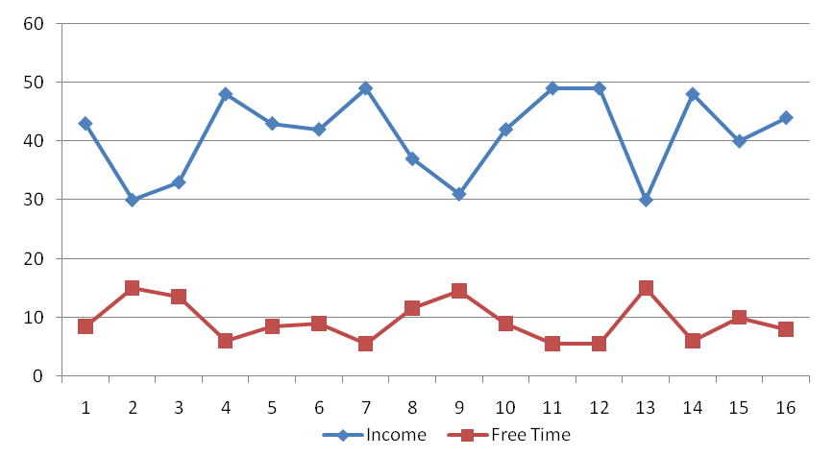
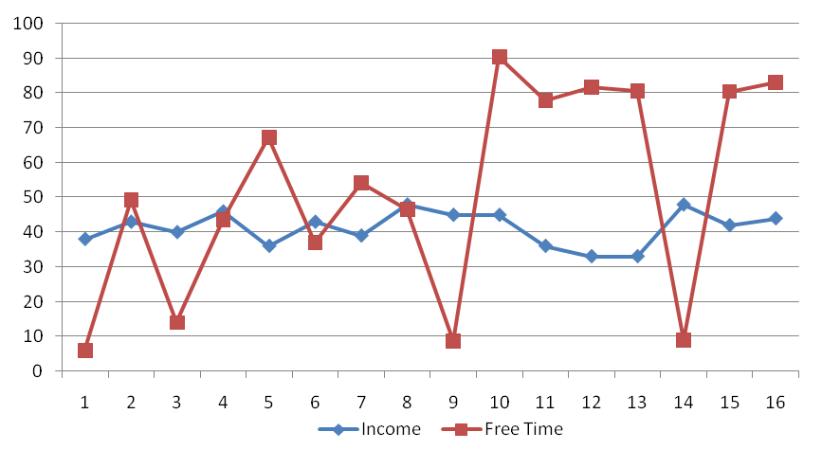
Correlation
Correlation measures the degree to which two variables are affecting each other i.e. if increasing a variable has any impact positive or negative on the other variable or not
Perfect positive Correlation
Perfect negative Correlation
No Correlation
There are two ways of measuring correlation
Pearson Correlation Co-efficient
Kendall Correlation Co-efficient
In SAS you can use PROC CORR to calculate correlation between two sets of variables

